Slide 1



ONLINE
QUIZ

Slide 2
OUTLINES
  OBJECTIVE OF ONLINE EXAM
  FEATURES OF ONLINE EXAM
  PROJECT REQUIREMENT
  PROJECT FORM

Slide 3
OBJECTIVE
  Main Objective behind to this Project is to make easy to conduct Paper.
Through Online Exam We can save the time expending between Paper and Result. The main idea behind developing this project is to provide fast way of conducting exam through internet. Through The Help of project, a person can be register free and give paper for checking his ability.

Slide 4
FEATURE OF ONLINE EXAM
  TIME SAVING
This Software also helps in saving time which expend in between Exam and Result. In this software user can found report card just after completing exam.
  FACILITY OF CHECKING PROPER ANSWER AFTER GETTING REPORT
This Software also provides facility of Checking Proper Answer after getting Result. This will help student to check his status of study, he will not be confused about Checking of Paper.
  A TIME LIMIT FOR PAPER
This software has a facility that there is time limitation for each paper and A clock is shown from starting of Exam to end of Exam. Through this type management all student will be get equal time which was decided by administrator for that particular Paper.

Slide 5
PROJECT REQUIREMENT
  H/W REQUIREMENT
Hard disk : 80 GB At least
RAM : 512 MB
Processor : 800 MHz At least
  S/W REQUIREMENT
    ASP.NET
    WAMP SERVER

Slide 6


Slide 7
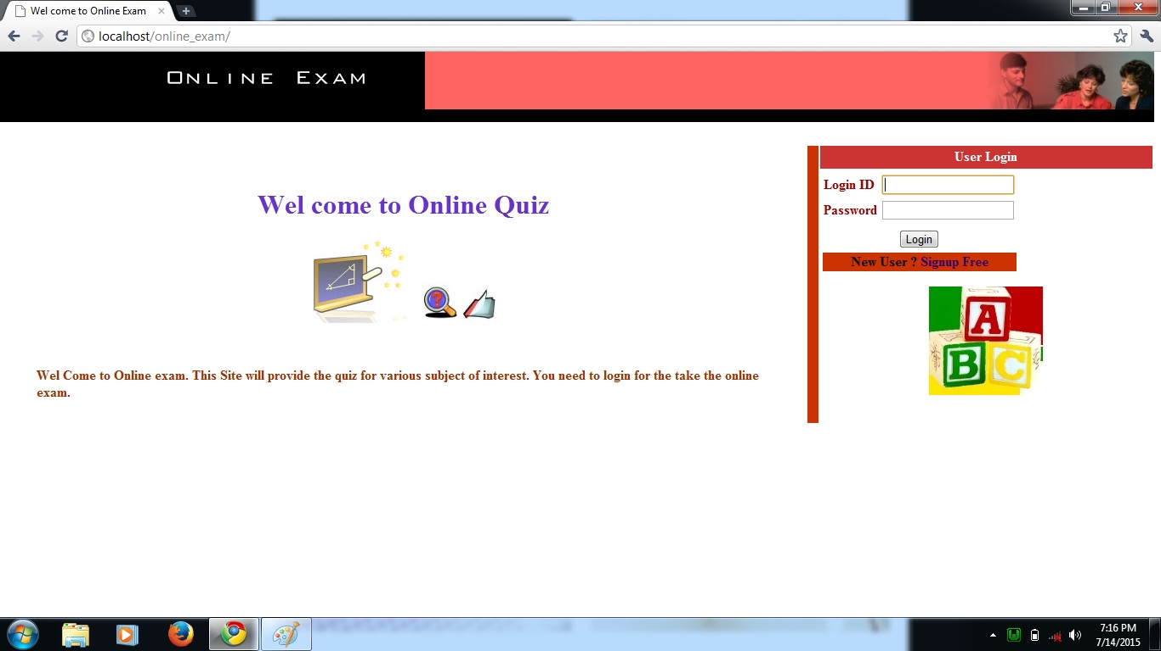
HOMEPAGE

Slide 8
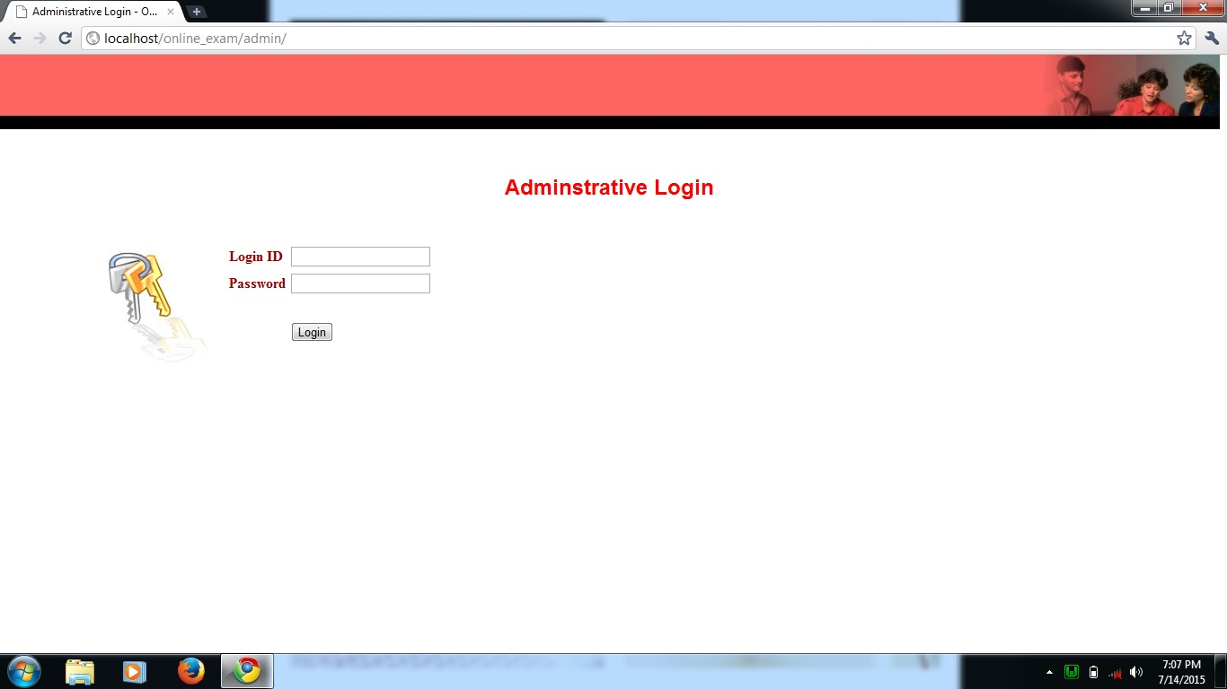
ADMIN LOGIN PAGE

Slide 9
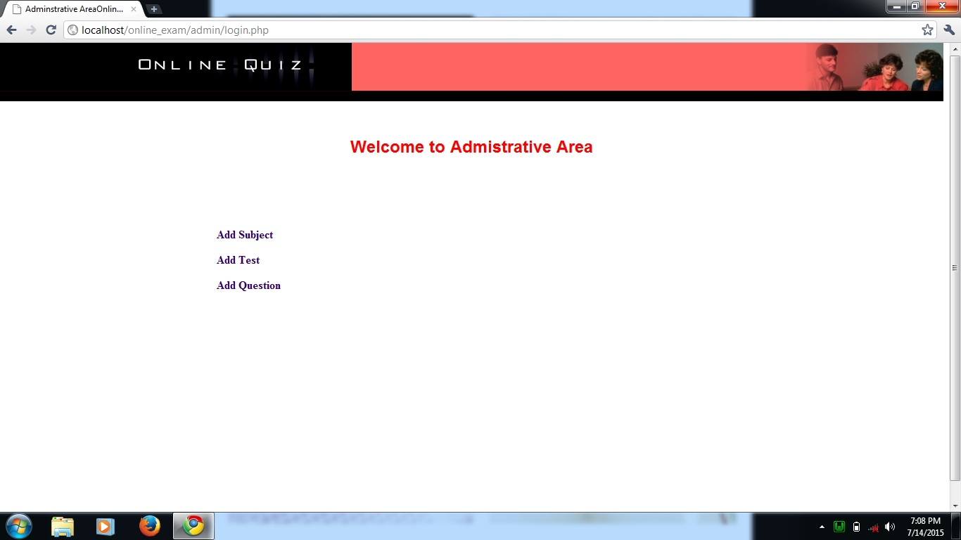
ADMIN ROLE…

Slide 10
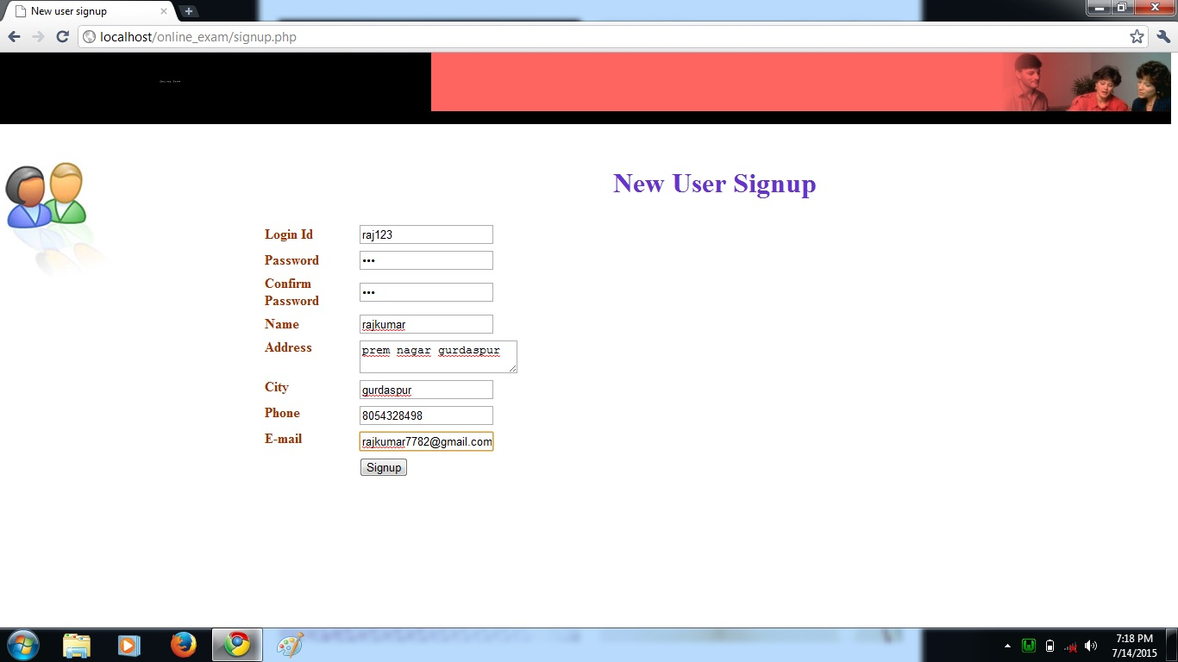
SIGN UP NEW USER…

Slide 11
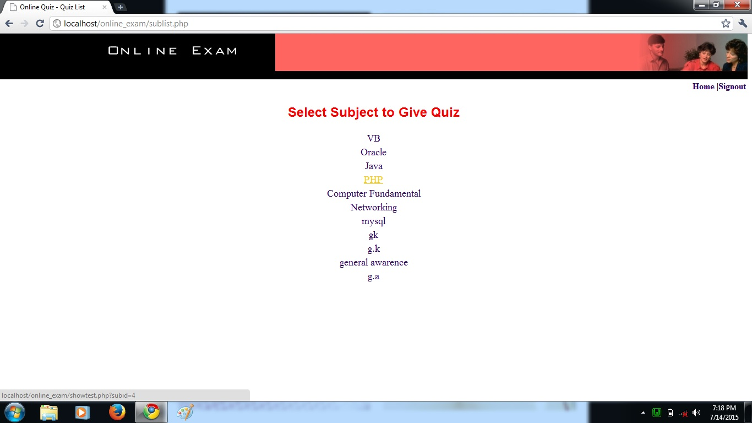
SELECT SUBJECT…

Slide 12

QUESTION…

Slide 13

REVIEW QUES./RESULT…

Slide 14


